Slide 1
Wesley Young’s PIG
Logos
layouts for your pages
Color Scheme ideas

Slide 2


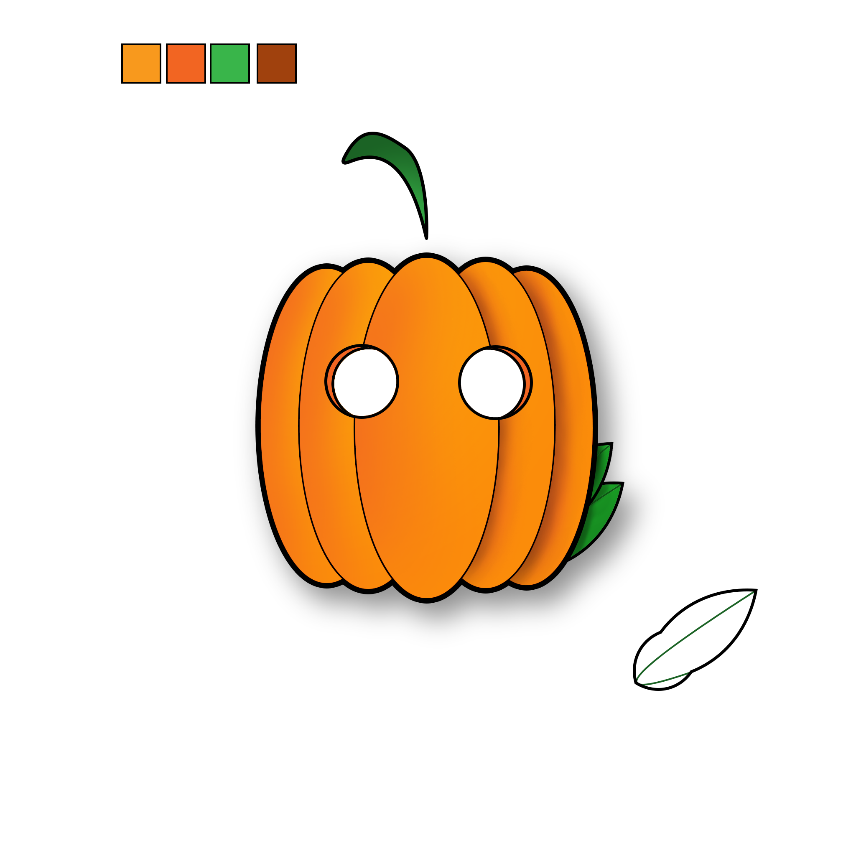


Logos
“homemade” logo from photoshop
Two ai logos
Hollowed logos

Slide 3
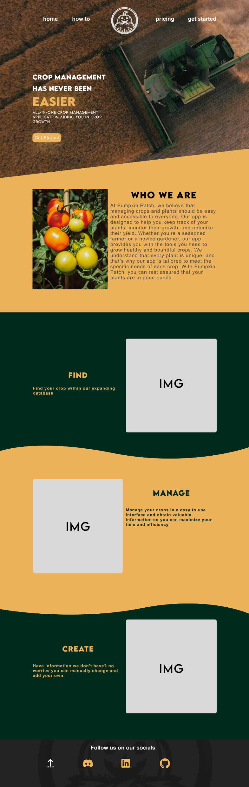
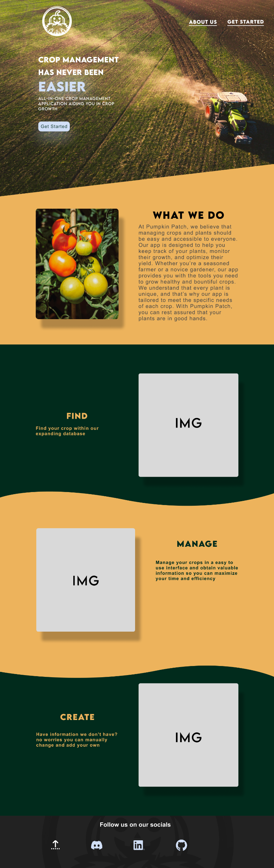
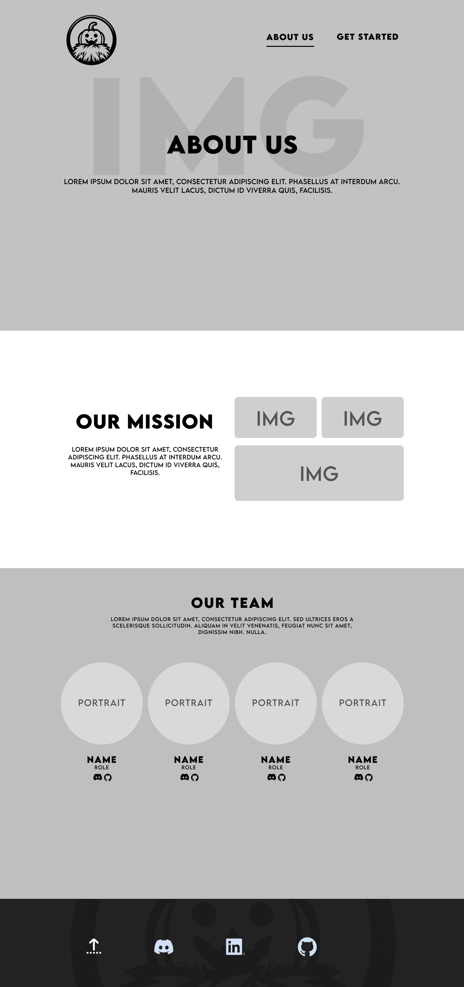
Layouts
Main page layout
Re-made Main page layout
Simple “about us” page layout

Slide 4
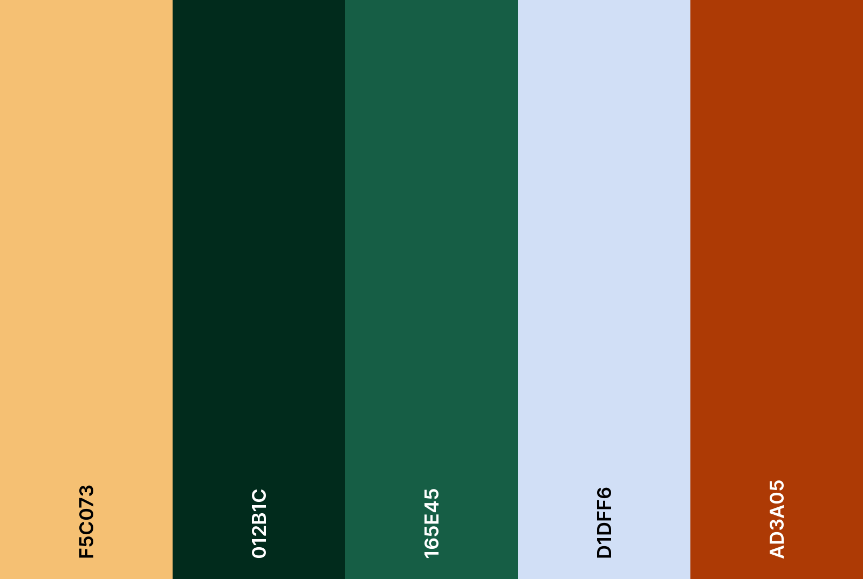
Current Color scheme

